Slide 1
RRC (Radio Remote Control App for Motorola Solution Enterprise Division
RRC App makes a connection between a personal phone and Apex two-way public safety radio
used by public safety departments (Police departments, health departments, etc).
This app uses Bluetooth connection over a range of 10-20 feet
Most of the functionality of this app is limited at this time due to unviability of public safety radio
and propriety information. So, only few screens will show up from a UI flow’s point of view.
Source code can’t be provided due to the propriety information. Apk and flow of the application is provided
In this presentation

Slide 2
General Understanding:
USB Samsung Driver (if one is using Galaxy Nexus phone). Please put “SAMSUNG” under Program files.
Android SDK with Eclipse and ADT plugin is needed to modify and build the application.
Install the RadioRemoteControl.apk in your phone. One can use adb_install.bat script to do just that.
Sometimes, pairing and connection between an Apex radio and a smart phone doesn’t happen. In that case, please clear the BT pairing from Apex radio. Please follow the instructions below:
i) Turn on the Apex radio
ii) Keep pressing “right arrow” button until one sees “BT” on the menu screen.
iii) Now, press the button right below where “BT” is written
iv) Keep pressing the “down arrow” button until one highlights the “Devices”
v) Now, press te button right below where “Clr” is written
vi) Now, press the button right below where “Yes” is written
vii) Power cycle the radio and then try again running the application
5) Once application builds in eclipse, one can find the apk under the following folder:
RadioRemoteControl → bin → RadioRemoteControl.apk
Organization of RRC Source Code
Bluetooth : RadioRemoteControl → src → com.motorola.rrc.bt (Java files)
DTAPI: RadioRemoteControl → src → com.motorola.rrc.dtapi (Java files)
UI: RadioRemoteControl → src → com.motorola.rrc.ui (Java files)
Logger file: RadioRemoteControl → src → com.motorola.rrc.nsc (Java files)
Layouts (screens) files: RadioRemoteControl → res → layout (XML files)
Images: RadioRemoteControl → res → drawable-hdpi
Strings: RadioRemoteControl → res → values → strings.xml
Styles: RadioRemoteControl → res → values → styles.xml (It has style for standard android Actionbar)
Menu: RadioRemoteControl → res → menu → activity_main_menu.xml, main_control_screen_menu.xml, menu_pair_to_new_radio.xml (these are the Actionbar Menu items xml files that are used in standard and splitactionbar menu)
AndroidManifest.xml: RadioRemoteControl → AndroidManifest.xml

Slide 3
Launching the RRC App
LF Pairing
BT Connection Establishment
LF Pairing Time out
Connection Time out
Unpair during the time out
Unpair
Zone/Channel Display
DTAPI (CodePlug, RRCData)
Logger

Slide 4
MainActivity.java
(activity_main.xml)
DTAPI Service Available
DTAPI is LF Paired
else
MainControlScreen.java
(activity_main_control_screen)
{Zone/Channel Main Screen}
MainActivity.java
(activity_main.xml)
{Pair to New Radio Screen}
AttemptingToConnect.java
(attempting_to_connect.xml)
{BT Establishment Screen}
DTAPI is LF Paired
Is BT Turned
ON??
NO
Pop UP Message
(AlertBox)
ALLOW??
YES
Click on
Pair to New Radio
Yes
NO
1st Time
BTConnectionTimeout.java
(activity_bt_connection_timeout.xml)
AttemptingLFPairing.java
(activity_display_message.xml)
{LF Pairing Instructions Screen}
Successful
MainControlScreen.java
(activity_main_control_screen)
{Zone/Channel Main Screen}
TRY AGAIN?
Unpair?
YES
LF Pairing Timed Out
PairingTimedOut.java
(activity_pairing_timed_out.xml)
TRY AGAIN
Unpair
MainActivity.java
(activity_main.xml)
{Pair to New Radio Screen}

Slide 5
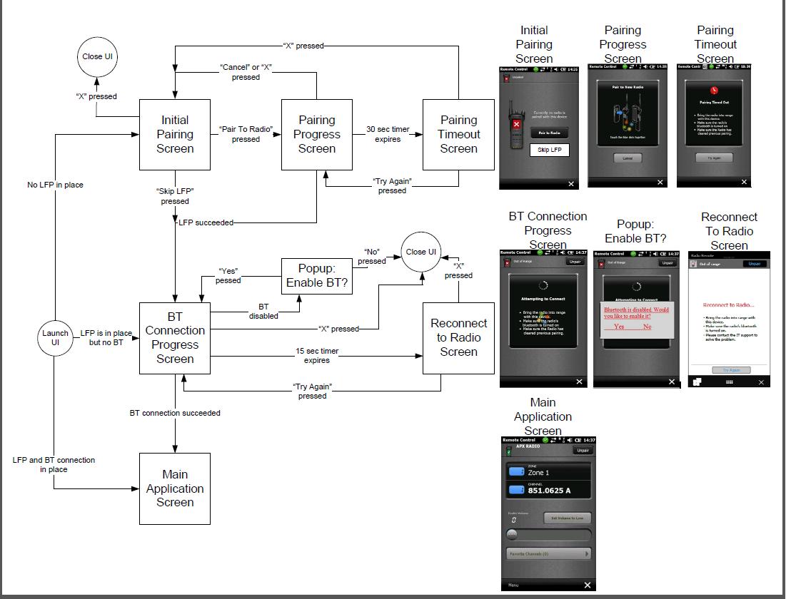

Slide 6
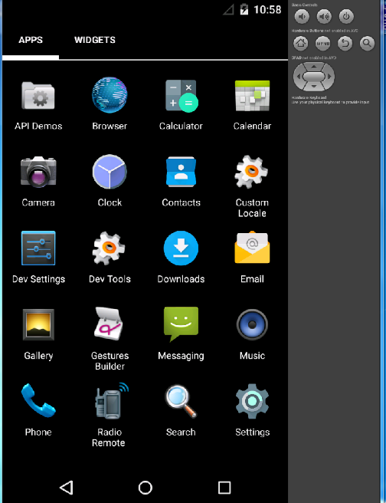
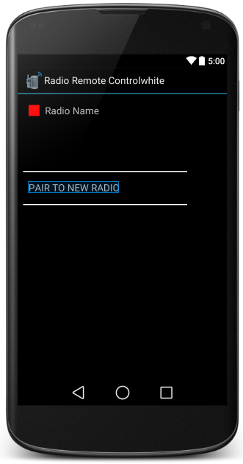
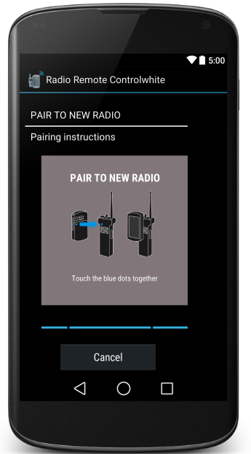
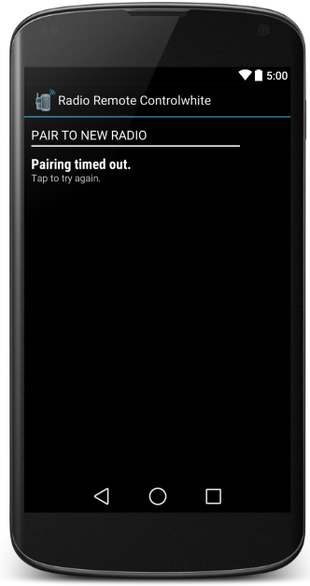
Pairing with Two-way Mobile Radio
RCC App Icon
App Launch Screen
Tap to try again

Slide 7
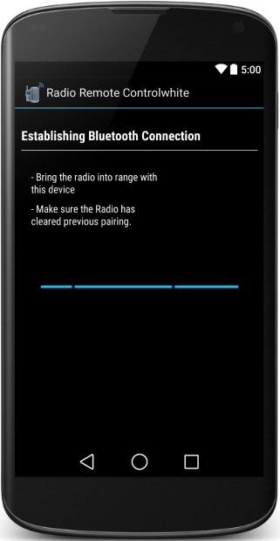
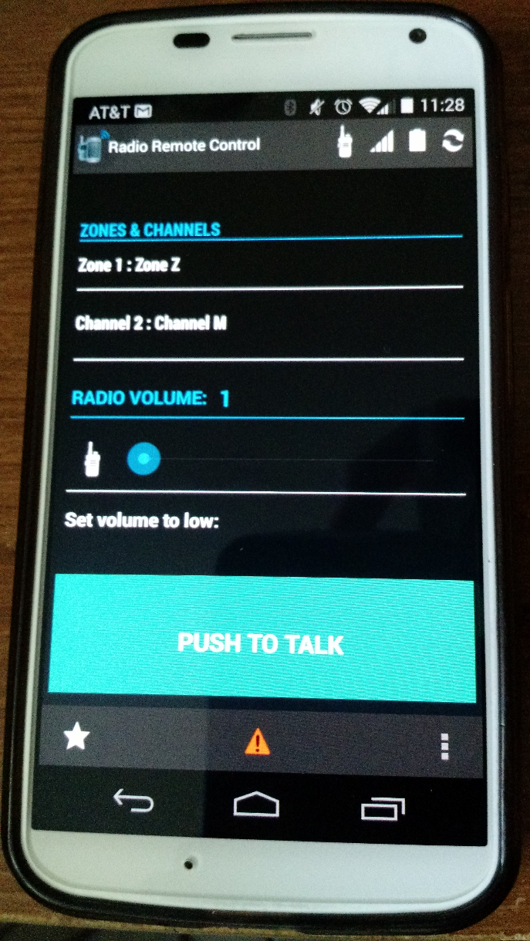
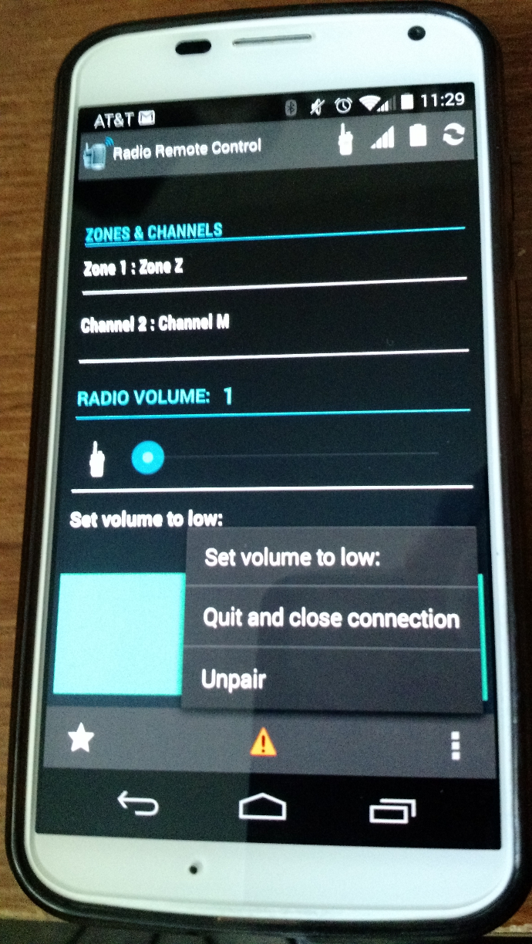
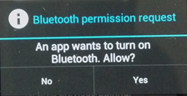
Turn on Bluetooth
Main Channel/Zone Screen
Main Channel/Zone Screen

Slide 8
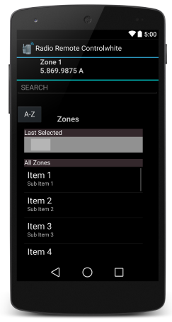
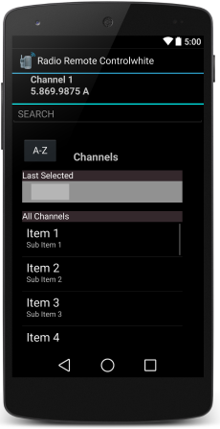
Zone Selection Screen
Channel Selection Screen

